Slide 1

MICRO PROJECT
INAI
Register
A Smart Peer Learning and Knowledge Sharing Platform
Inai is an ancient Tamil word meaning connection: connecting the right student to the right knowledge at the right time.
Match
Team: MappillaiMeeran A & Dhinesh S
Connect
College: SMVEC
Department: MCA
Date: 9 June 2026

Slide 2

PROBLEM
Hostel students have nearby help, but no safe way to discover it.
Existing solutions still miss the system layer
Late -Night Doubts
Roommate Mismatch
Unsafe Interactions
DSA, Java, OS doubts during exam hours.
Random pairing creates lifestyle conflicts.
Unknown neighbours feel awkward to approach.
WhatsApp
No skill filter
No algorithm
Friends
Limited reach
No discovery
No Intelligent Matching
Out-of-State Isolation
Unorganized Tools
YouTube
Generic content
No syllabus fit
Need both instant help and best-fit matching.
Language/state familiarity is hard to find.
Groups and notices are noisy, stale, and unfiltered.
Class Groups
Only classmates
No hostel-wide
discovery
Nothing
Silent struggle
No platform
"Learning resources exist around you - but remain invisible."
INAI | Smart Study Partner & Roommate Matching System
02

Slide 3
SOLUTION
INAI turns student profiles into safe, ranked academic connections.
Register
Match
Connect Safely
1
Skills, hostel, block, subjects, lifestyle
2
Quick, Preference, or Roommate ranking
3
Request first; room reveals only after accept
Preference scoring model
Proximity
40%
Same block/hostel
Live example
Skill complement
30%
Need ∩ their strong subject
Saravanavelu needs DSA help
Academic fit
20%
Same branch + same year
Muthu Pandi: same block + DSA Expert + same branch
State/language
10%
Familiar peer support
40 + 30 + 10 = 80% Match -> sorted to top
INAI | Smart Study Partner & Roommate Matching System
03

Slide 4
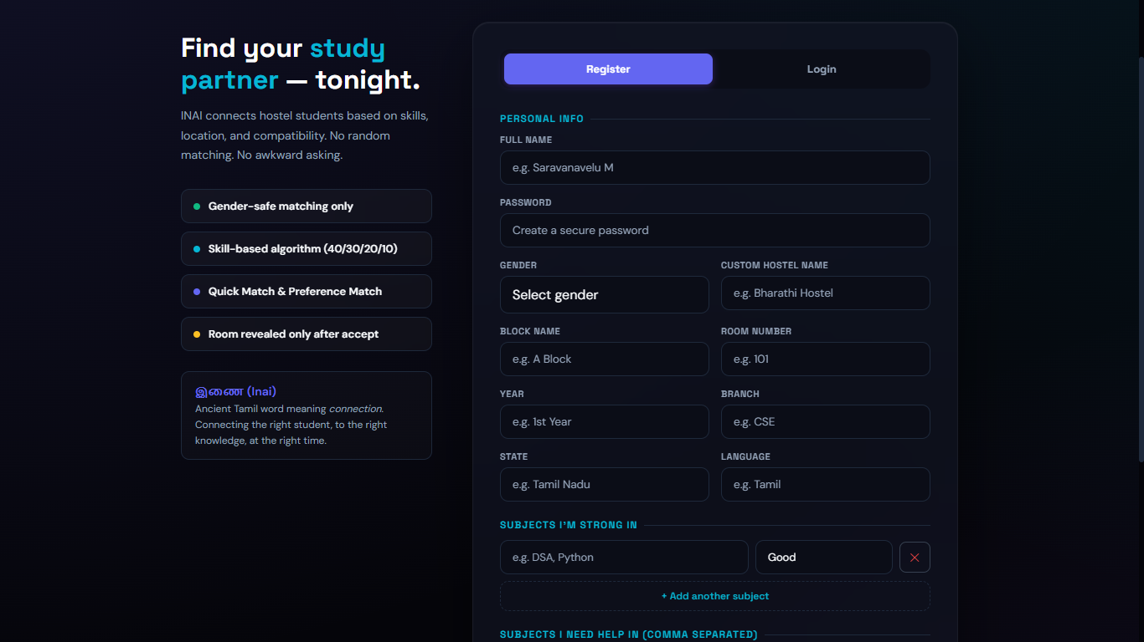
Register Page:

Slide 5
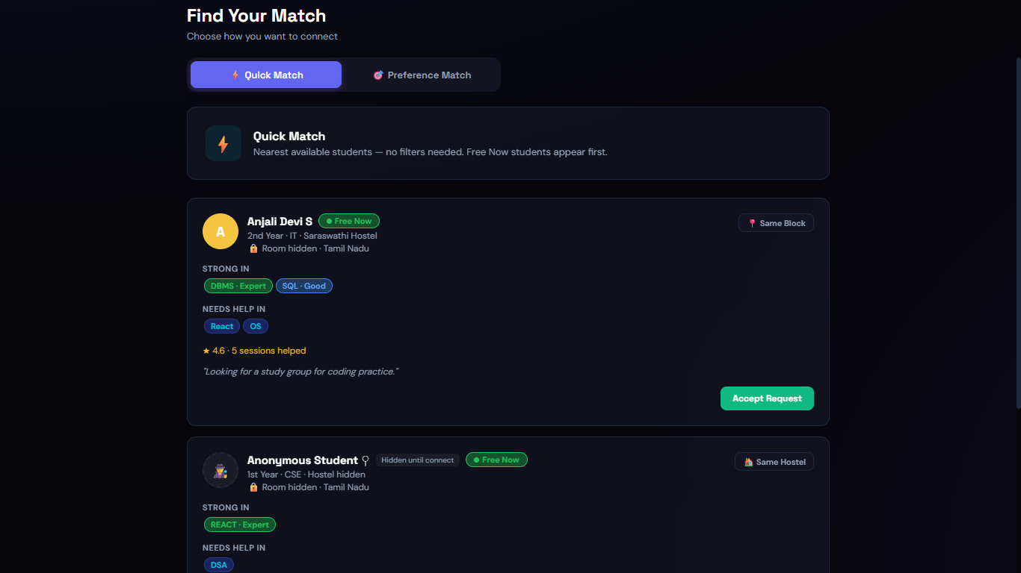
Find Match&
Preferance:

Slide 6
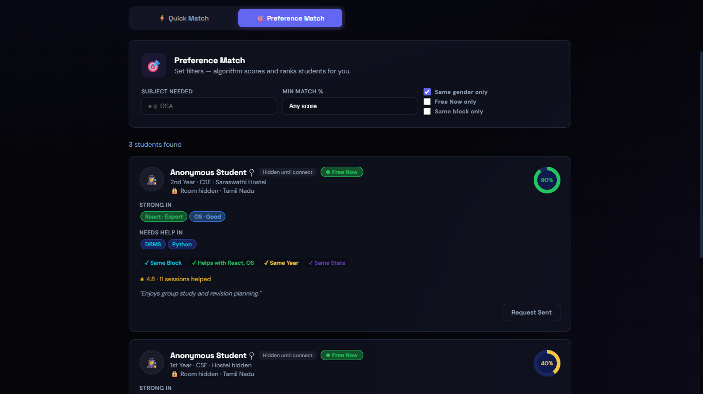

Slide 7
ARCHITECTURE
The updated version uses a real backend and MongoDB Atlas persistence.
Browser UI
REST API
MongoDB Atlas
HTML5, CSS3, Vanilla JS
Dashboard, Match, Map, Admin
Node.js + Express
Auth, users, matches, requests
Cloud NoSQL database
Users, requests, sessions, rooms
Security and control layer
PBKDF2 password hashing
HMAC/JWT-style tokens
Privacy middleware
Rate limiting
120,000 iterations; timing-safe verification
User and admin routes separated
Room/name hidden until mutual connection
Brute-force protection for login/admin
Tech stack: Node.js, Express.js, MongoDB Atlas, Mongoose, Vanilla HTML/CSS/JavaScript
INAI | Smart Study Partner & Roommate Matching System
04

Slide 8
FEATURES
The product now covers discovery, coordination, privacy, productivity, and admin control.
Matching & safety
Study workflow & operations
Quick Match
Nearby and Free Now students first
Study Sessions
Propose, confirm, complete, and rate sessions
Preference Match
Subject, score, branch, year, state filters
Group Study Rooms
Create/join room-based group learning
Roommate Match
Lifestyle compatibility: sleep, study style, cleanliness
Chat
Connected students can message safely
Hostel Map
Room-level visual map scoped to own hostel
Admin Panel
User management, stats, moderation
Privacy Model
Anonymous until request is accepted
Pomodoro Timer
25-minute focus timer plus brain-break game
INAI | Smart Study Partner & Roommate Matching System
05

Slide 9
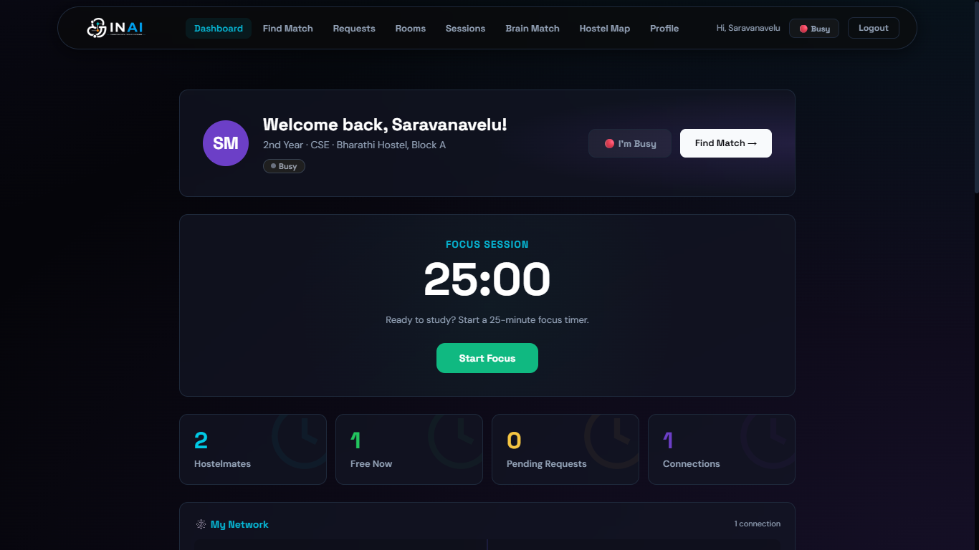
Dashboard:

Slide 10
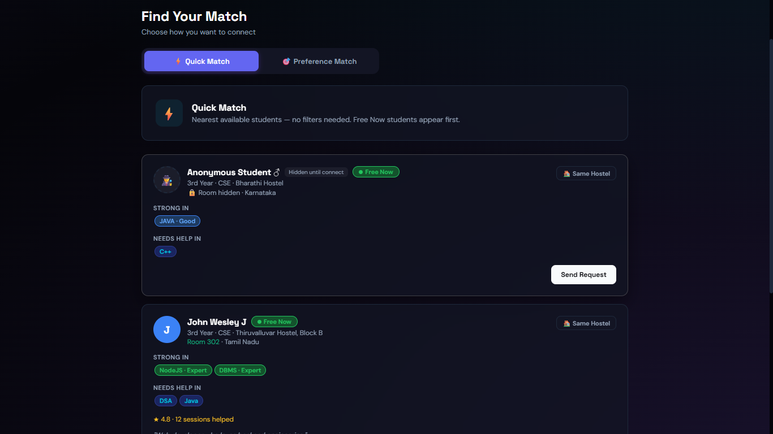
Quick Match:

Slide 11
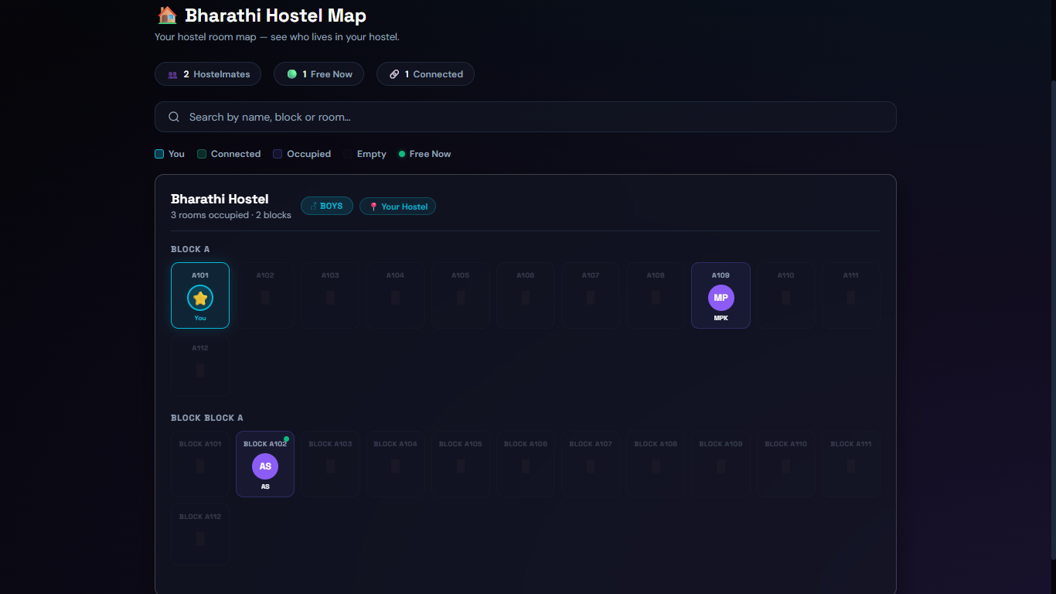
Hostel Map:

Slide 12
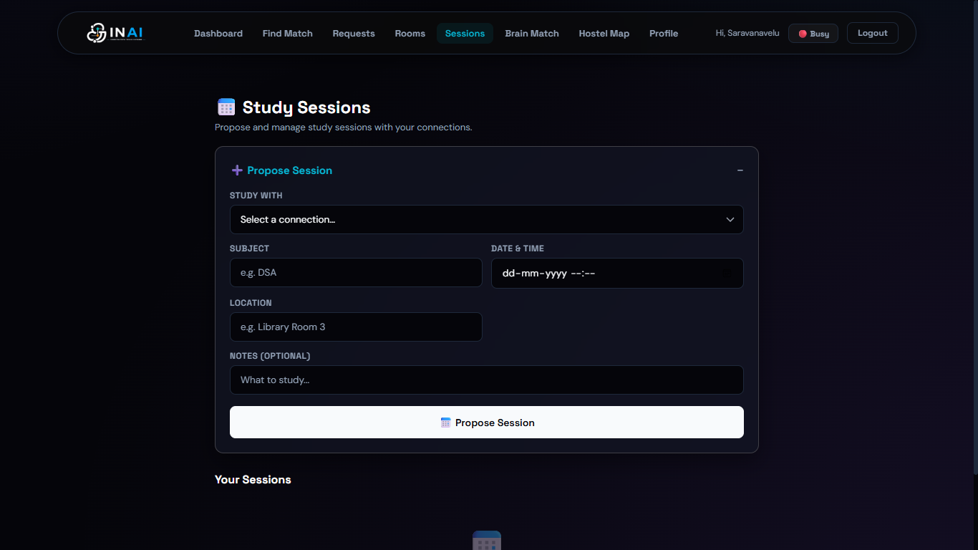
Session Page:

Slide 13
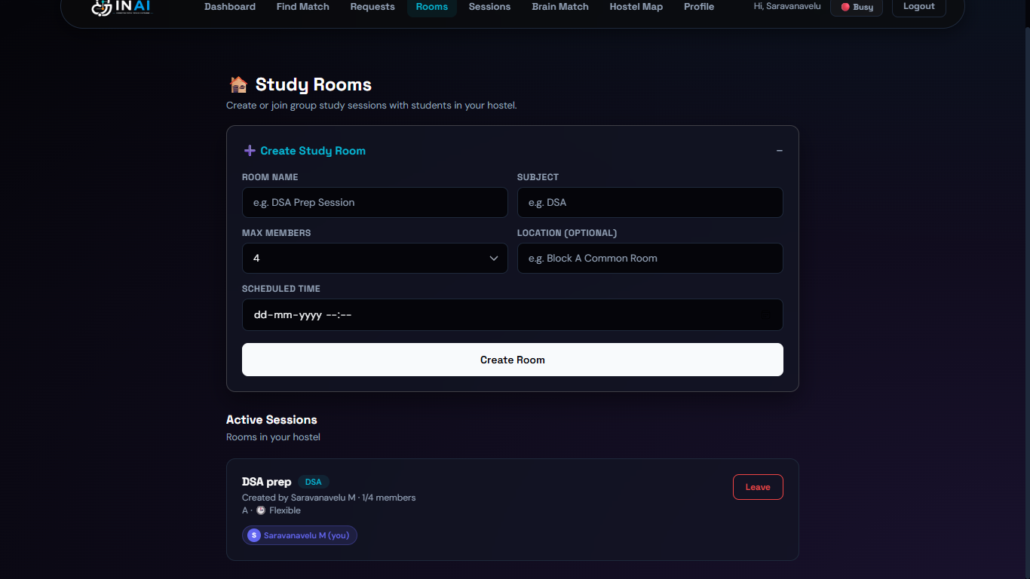
Study Rooms:

Slide 14
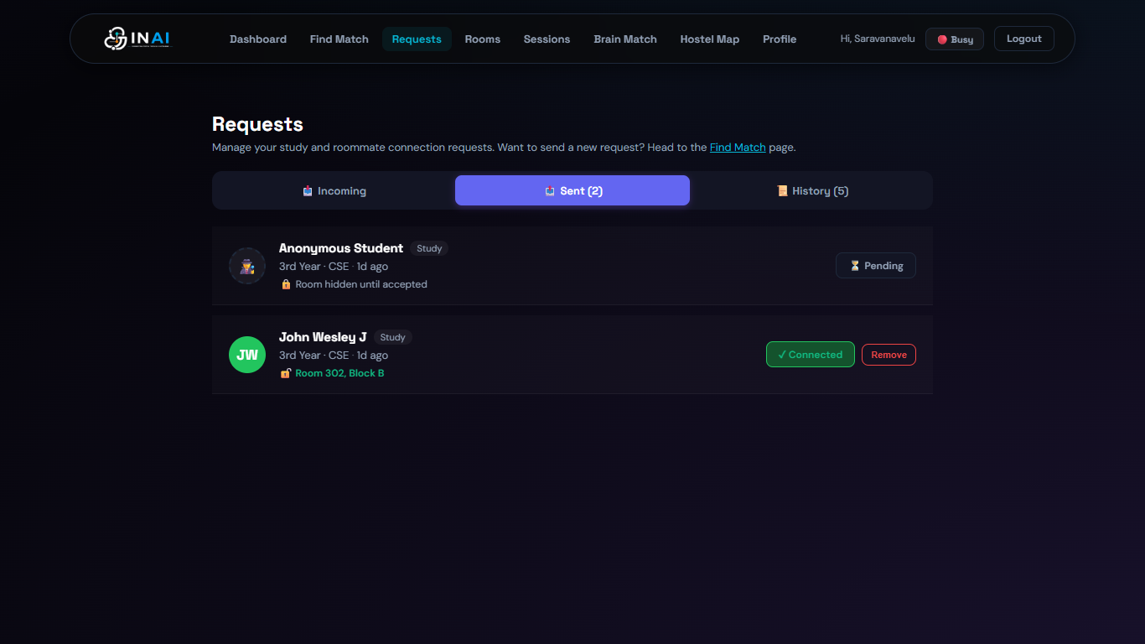
Request Page:

Slide 15
TESTING
The system passed validation across matching, privacy, security, and performance.
46
100%
<1.5s
<200ms
PBKDF2
test cases
gender safety
page load
API average
security
All passed
Same-hostel/gender scope
Local network pages
Backend response
120,000 iterations
Matching logic
Quick, Preference, Roommate ranking; gender defaults
Pass
Privacy
Names/rooms hidden until mutual accept
Pass
Security
PBKDF2, HMAC tokens, admin route isolation, rate limit
Pass
Integration
Users, requests, sessions, chat, rooms, admin delete cascade
Pass
Bugs fixed
6 issues including request stub, room stripping, map scope
Closed
Testing evidence from INAI lab record and implemented modules
06

Slide 16
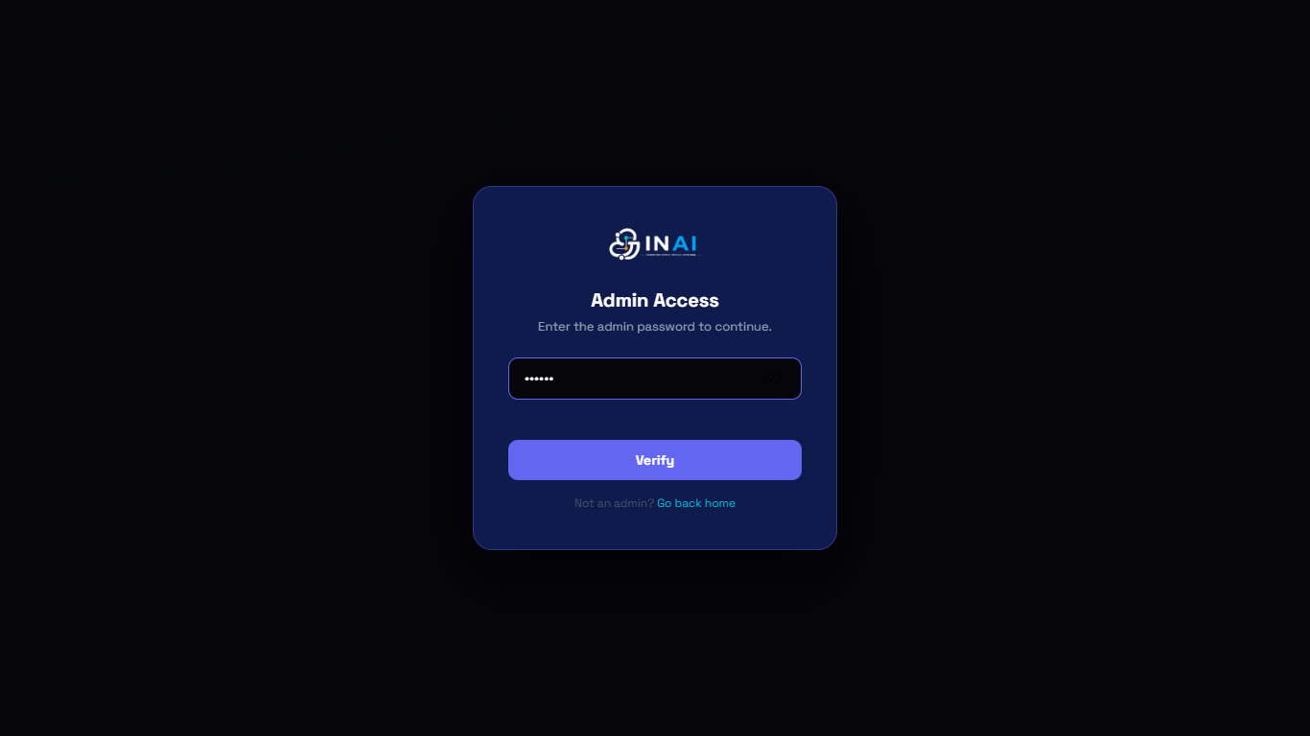
Admin Page:

Slide 17
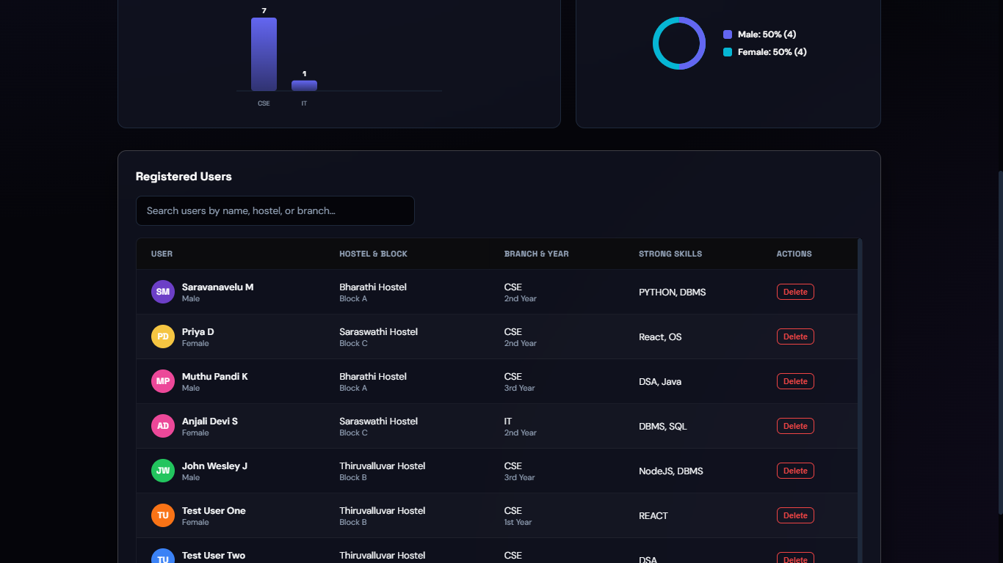

Slide 18
CONCLUSION
INAI is no longer just a prototype; it is a tested campus-ready web system.
What we built vs future version
Future scope
Built now
Future version
WebSocket
Real-time chat and live map status
MongoDB-backed student profiles
College email OTP verification
PWA
Mobile install, offline shell, push alerts
Gender-safe matching and hostel map
Authority-approved hostel integration
Room reveal only after mutual accept
Reputation and helper leaderboard
AI Matching
Learn from ratings and session outcomes
Polling chat and notifications
WebSocket real-time updates
Authority Integration
Verified hostel and admin workflows
Browser web app
PWA with push notifications
Multi-language
Tamil/English support for broader access
"Other apps connect friends. INAI connects knowledge."
INAI | Smart Study Partner & Roommate Matching System
07

